Slide 1
Aboriginal and Torres Strait Islander Digital Archive
ATSIDA - A node of the Australian Data Archive (ADA)
Prof. N. M. Nakata (B.Ed. Hons. PhD) & Ms. K. Thorpe
Indigenous digital data and the archives

Slide 2
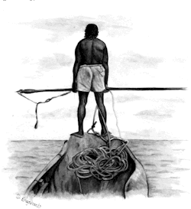

Slide 3
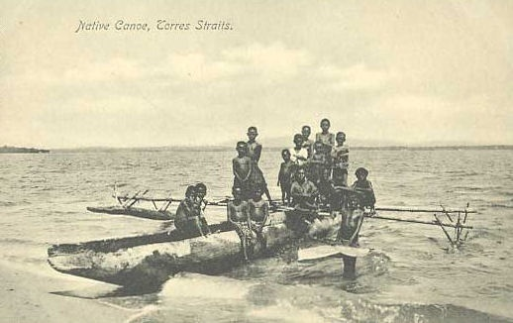


Slide 4
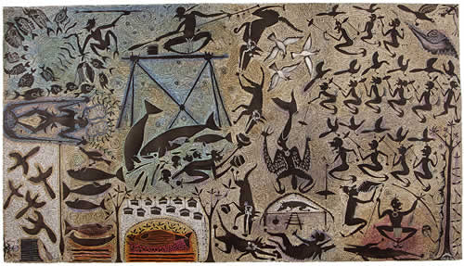
`

Slide 5
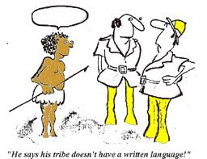

Slide 6
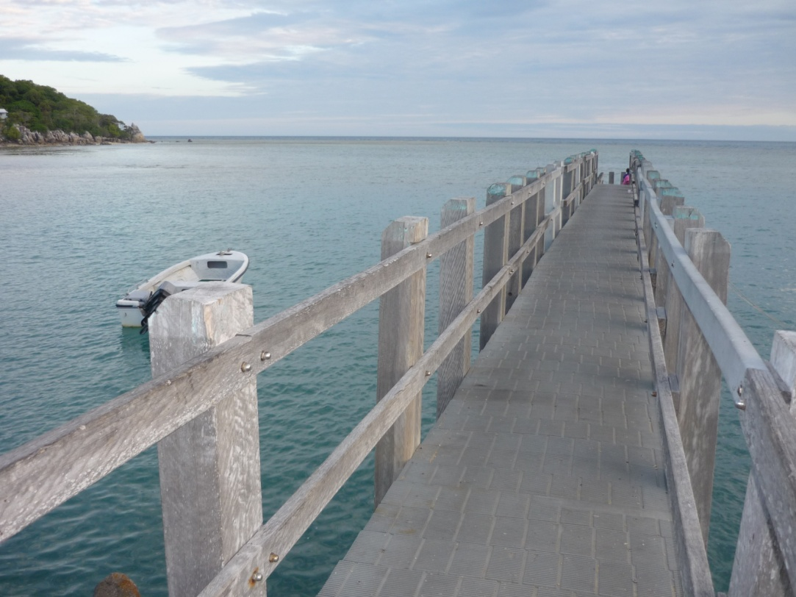

Slide 7


Slide 8
Corpus of Knowledge
About Us
Indigenous Knowledge
Contested Knowledge Spaces
Notes:
Let’s recap.

Slide 9
The Cultural Interface
Corpus of Knowledge
About Us
Indigenous Non-Indigenous
Episteme
Knowledge
People
Language
Community
Culture
Identity
Histories
Episteme
Knowledge
People
Language
Community
Culture
Identity
Histories
Indigenous Knowledge
Contested Knowledge Spaces
The Contemporary Indigenous Space

Slide 10
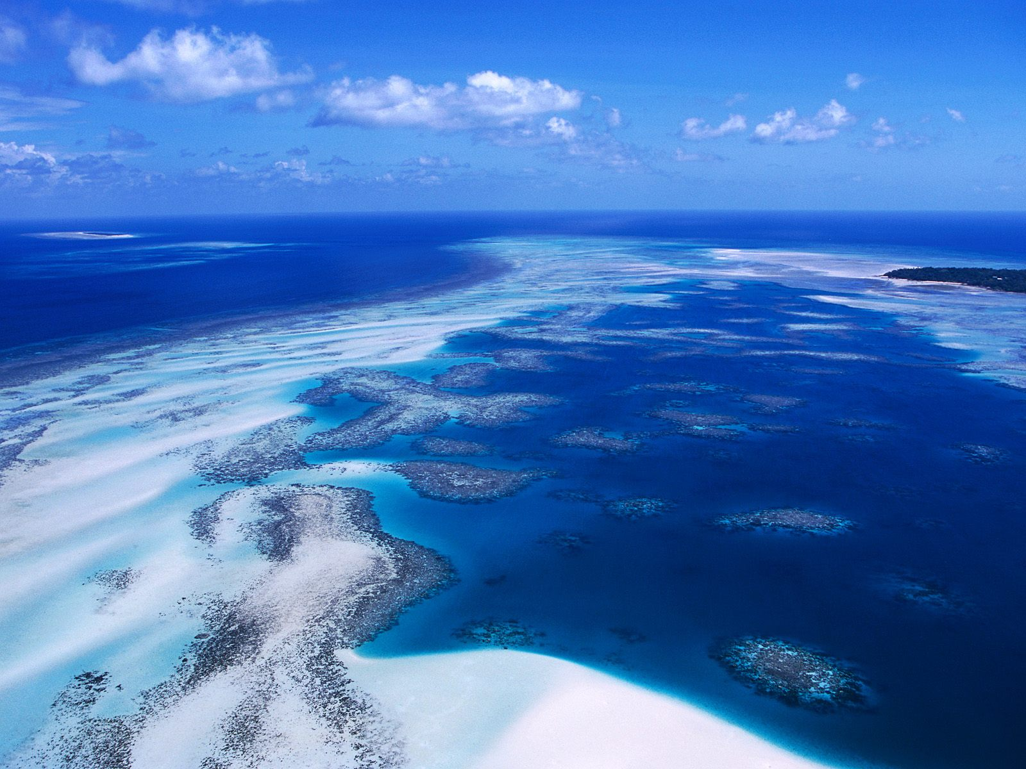

Slide 11
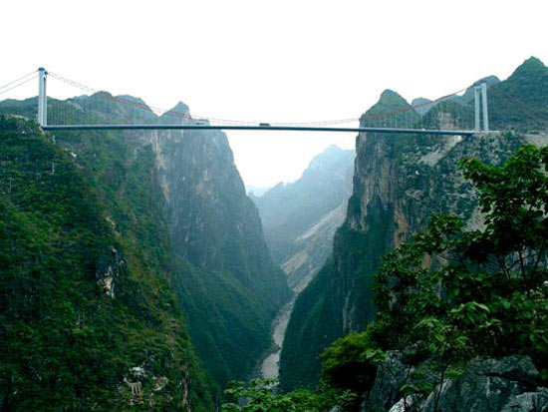
Notes:
So my question to you all is whether Indigenous education is about bridges? Or is the divide a figment of our imagination?

Slide 12
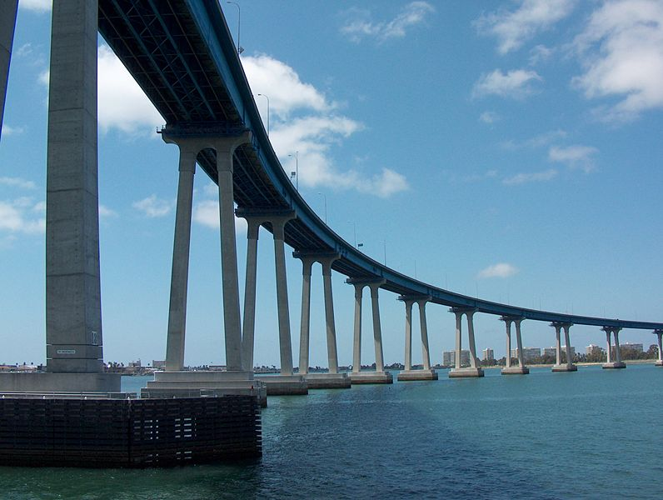
Notes:
And we too have come to question the endless quest to build the right bridges?

Slide 13

We are in a closed box and wait for the lid to be taken off. (Torres Strait Islander to Deputy Chief Protector in Report 22 February 1936, p. 3)

Slide 14


Slide 15

What is data – what is sensitive data
Database – repositories
Federated systems – epistemological & ontological structures

Slide 16
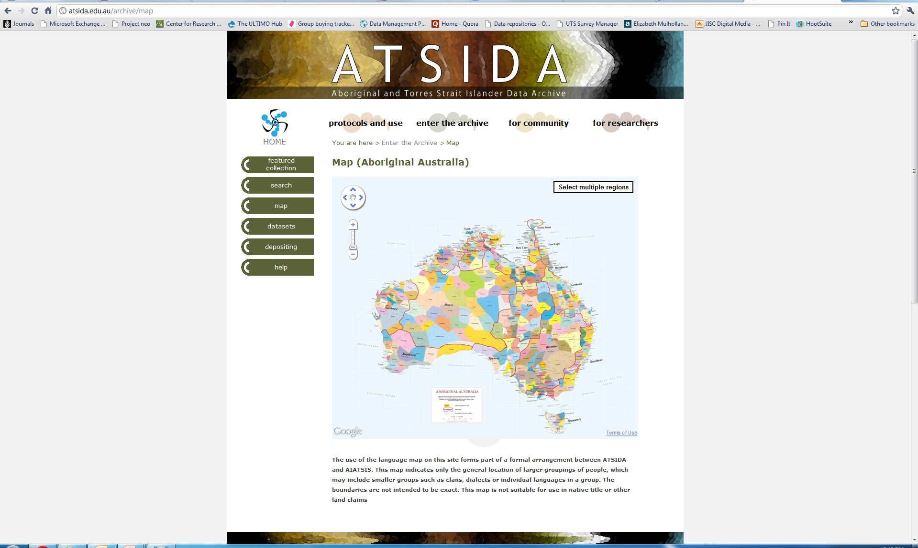
ATSIDA
ATSIDA
A national project to preserve digital research data
ATSIDA is a specialised trusted research data management facility for Australian Indigenous research data and is managed by UTS Library.
ATSIDA is a thematic archive within the Australian Data Archive (ADA) with its datasets stored securely at the National Computational Infrastructure (NCI) (formerly the Australian National University (ANU) Supercomputer Facility).
www.atsida.edu.au

Slide 17
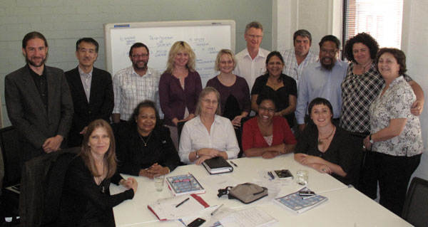
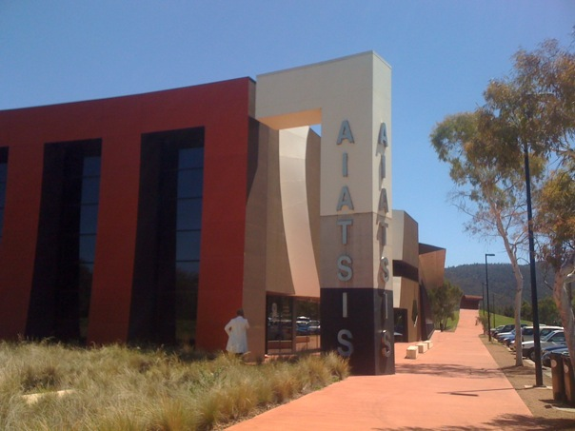
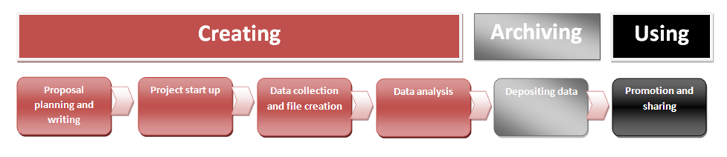

ATSIDA
ATSIDA Reference Group
Collaborating
MOU with AIATSIS
Work with Researchers
UTS – Jumbunna Indigenous House of Learning

